Slide 1


Exploring Data Manipulation and Visualization
Wake Forest
School of Business
_______
Day 5

Slide 2
Agenda
Recap & Objectives
Data Manipulation
Group By and Aggregate
Visualization with Seaborn
Key Recipes
Wrap-up
Notes:
Day 5: Exploring Data Manipulation and Visualization
Slide 1: Title and Introduction
Bootcamp Recap and Objectives
Day 5: Exploring Data Manipulation and Visualization
Slide 2: Recap and Warm-up
Briefly summarize the topics covered in the previous days.
Ask participants if they have any questions or need clarification on any topics.
Slide 3: Basic Arithmetic with Series Objects
Introduction to Series objects and their importance in data analysis.
Perform basic arithmetic operations with Series objects using pandas.
Addition: series1 + series2
Subtraction: series1 - series2
Multiplication: series1 * series2
Division: series1 / series2
Handling missing or null values during arithmetic operations.
Use the fillna() function to handle missing values.
Demonstrate how to handle missing values in different scenarios.
Slide 4: Group By and Aggregation
Understanding the concept of grouping data in pandas.
Grouping data based on one or more columns using the groupby() function.
Applying aggregation functions to grouped data:
Mean: grouped_data.mean()
Sum: grouped_data.sum()
Count: grouped_data.count()
Using the agg() function to perform multiple aggregations simultaneously.
Example: grouped_data.agg({'column1': 'mean', 'column2': 'sum'})
Slide 5: Introduction to Seaborn
Overview of Seaborn, a Python data visualization library.
Importance of data visualization in exploratory data analysis.
Install Seaborn using pip: pip install seaborn
Import Seaborn in Python: import seaborn as sns
Slide 6: Creating Basic Visualizations with Seaborn
Create scatter plots using sns.scatterplot().
Create line plots using sns.lineplot().
Create bar plots using sns.barplot().
Customize plot aesthetics:
Set colors: sns.set_palette()
Set labels: plt.xlabel(), plt.ylabel(), plt.title()
Slide 7: Seaborn Visualization Examples
Histograms and KDE plots:
Use sns.histplot() for histograms.
Use sns.kdeplot() for KDE plots.
Box plots and violin plots:
Use sns.boxplot() for box plots.
Use sns.violinplot() for violin plots.
Heatmaps and correlation matrices:
Use sns.heatmap() for heatmaps.
Use sns.heatmap() or sns.clustermap() for correlation matrices.
Pair plots and scatter matrix plots:
Use sns.pairplot() for pair plots.
Use sns.pairplot() or sns.scatter_matrix() for scatter matrix plots.
Slide 8: Best Practices for Data Visualization
Discuss best practices for choosing appropriate visualizations based on data characteristics and research questions.
Consider the type of data (categorical, numerical, etc.).
Consider the research questions or hypotheses to be explored.
Emphasize the importance of clear and informative visualizations.
Slide 9: Wrap-up and Conclusion
Summarize the key topics covered during the bootcamp.
Address any remaining questions or concerns from participants.
Provide additional resources for further learning and practice.
Encourage participants to continue

Slide 3

5.1 Python Syntax Review

Slide 4
Recap
Print
f”{}” and “{}”.format() print and numbers
Basic Math
Loops
Pandas
Matplotlib
What else?
var1 + var2
Data Types
float, string, list, dict
for and while
import / export
histogram, barchart, boxplot

Slide 5
5.2 Pandas Review

Slide 6
Pandas Data Manipulation
Data Type Conversion
Character to numeric
Character to Date / Datetime
String Manipulation
str.lower() / str.upper(),
str.replace()
str.extract()
str.contains()
str.strip() / str.lstrip() / str.rstrip()
pd.to_datetime(df['date_column’])
dt.year,
dt.month,
dt.day,
dt.hour,

Slide 7
Character to numeric CONVERSION
astype() function converts a column or Series to a specified data type.
astype(float) or astype(int) converts character columns to floating-point or integer.
Syntax:
df['column_name'] = df['column_name'].astype(float)
pd.to_numeric() function converts a column or Series of characters to numeric type.
It handles various formats, including integers, floats, and scientific notation.
USE THIS WHEN YOU NEED MORE CONTROL!
Syntax:
df['column_name'] = pd.to_numeric(df['column_name'], errors='coerce')

Slide 8
Character to Date / Datetime
pd.to_datetime() function converts a column or Series of characters to date or datetime type.
It can handle various date formats, including ISO 8601, custom formats, and Unix timestamps.
Syntax:
df['column_name'] = pd.to_datetime(df['column_name’])
df['date_column'] = pd.to_datetime(df['date_column’],
format='%Y-%m-%d’)

Slide 9
Character or String Manipulation
str.lower() and str.upper():
str.lower() converts all characters in a string to lowercase.
str.upper() converts all characters in a string to uppercase.
Example:
df['column_name'].str.lower()
str.replace():
str.replace() replaces occurrences of a substring with another substring within a string.
It supports both literal and regex-based replacements.
Example:
df['column_name'].str.replace('old_value', 'new_value')

Slide 10
Character or String Manipulation
str.contains():
str.contains() checks if a pattern or substring exists in a string.
It returns a Boolean Series indicating whether the pattern is found in each string.
Example:
df['column_name'].str.contains('pattern’)
str.strip(), str.lstrip(), and str.rstrip():
str.strip() removes leading and trailing whitespace characters from a string.
str.lstrip() removes leading whitespace characters.
str.rstrip() removes trailing whitespace characters.
Example:
df['column_name'].str.strip()

Slide 11
Extract and Regular Expressions
str.extract():
str.extract() extracts substrings from a string using regular expressions.
It returns a new Series with extracted values.
Example:
df['column_name'].str.extract(r'(\d+)-(\w+)’)
Regular expressions consist of patterns made up of literal characters, metacharacters, and special symbols. Patterns define the rules for matching or searching within text.

Slide 12
Regular Expressions aka Regex
Patterns: Regular expressions consist of patterns made up of literal characters, metacharacters, and special symbols.
Metacharacters: Metacharacters have special meanings in regular expressions. common metacharacters include:
. (dot): Matches any single character except a newline.
*: Matches zero or more occurrences of the preceding element.
+: Matches one or more occurrences of the preceding element.
?: Matches zero or one occurrence of the preceding element.
[]: Matches any single character within the brackets.
|: Acts as a logical OR, matching either the expression before or after it.
Special Symbols: Regular expressions use special symbols for specific purposes. commonly used symbols include:
\d: Matches any digit (0-9).
\w: Matches any alphanumeric character (a-z, A-Z, 0-9, and underscore).
\s: Matches any whitespace character (space, tab, newline).
^: Matches the start of a line.
$: Matches the end of a line.

Slide 13
More Regex
Quantifiers:
Quantifiers specify how many times an element should occur. Common quantifiers include:
*: Matches zero or more occurrences.
+: Matches one or more occurrences.
?: Matches zero or one occurrence.
{n}: Matches exactly n occurrences.
{n, m}: Matches between n and m occurrences.
Anchors:
Anchors specify the position in the text where a match should occur. Common anchors include:
^: Matches the beginning of a line.
$: Matches the end of a line.

Slide 14
A pattern for emails
email_pattern = r'^[\w\.-]+@[a-zA-Z0-9-]+\.[a-zA-Z]{2,}$’
‘r’ prefix before the pattern string is called a "raw string literal" in Python.
It indicates that the string should be treated as a raw string (don’t escape)
‘^’ and ‘$’ denote the start and end of the string.
[\w\.-]+ matches one or more-word characters
(alphanumeric and underscore), dots, or hyphens before the @ symbol.
@[a-zA-Z0-9-]+ matches the @ symbol followed by
one or more alphanumeric characters or hyphens.
\.[a-zA-Z]{2,} matches a dot followed by
two or more alphabetical characters for the domain extension.

Slide 15
Adding Pandas Columns Together
Series: One-dimensional labeled array capable of holding any data type.
Perform basic arithmetic operations with Series objects.
Addition: series1 + series2
Subtraction: series1 - series2
Multiplication: series1 * series2
Division: series1 / series2

Slide 16
Conditionals with NumPy
NumPy: Numerical Computing with Python
NumPy (Numerical Python) is a fundamental library for numerical computing in Python.
It provides efficient data structures for handling large arrays and matrices.
NumPy is the foundation for many other libraries and applications including PANDAS!
np.where(): Conditional Operation
The np.where() function in NumPy provides a way to perform conditional operations.
Example: np.where(condition, x, y)
condition: The condition to be checked element-wise.
x: The value to be selected where the condition is True.
y: The value to be selected where the condition is False.
df[‘x_or_y’] = np.where(df[‘column’, x, y)

Slide 17
Seaborn
An easier and more visually appealing package
replot
Relationships
scatterplot
lineplot
distplot
Distributions
histplot
kdeplot
catplot
Categorical
barplot
boxplot

Slide 18
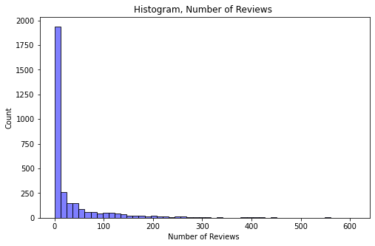
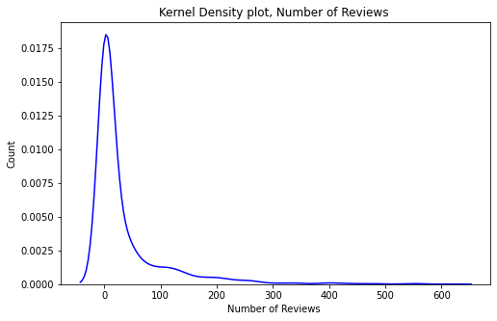
Distributions
Histplot & kdeplot
histogram – sns.histplot(x = numeric_series, bins=50, color='blue', alpha=0.5)
A kernel density estimate (KDE) plot is a method for visualizing the distribution of observations in a dataset, analagous to a histogram.
sns.kdeplot(abnb['number_of_reviews'], color='blue', alpha=0.5)
Notice you don’t pass it a number of bins.

Slide 19
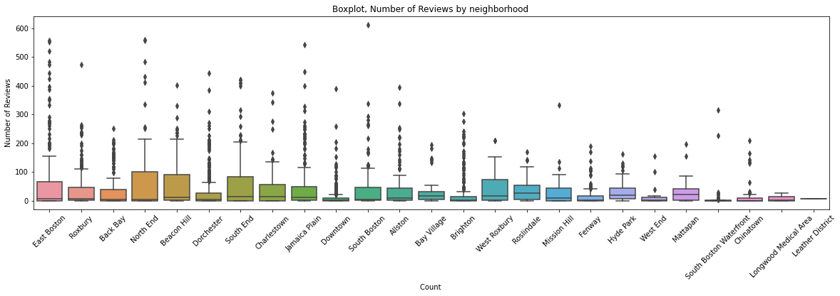
Categorical Data
boxplot
How can I compare?
sns.boxplot(x = abnb['neighbourhood'], y=abnb['number_of_reviews'] )

Slide 20
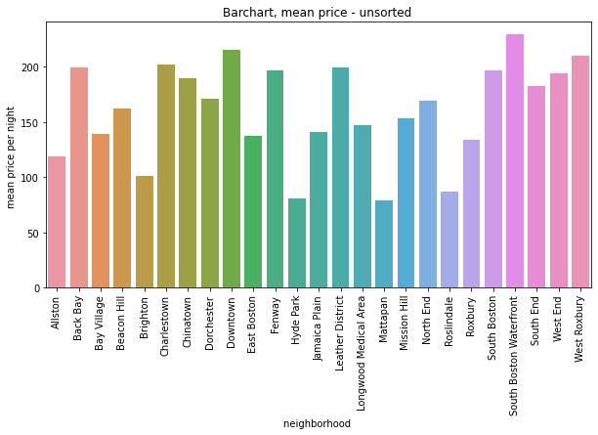
Categorical Data
Bar Plot
How can I compare
sns.barplot(x=res1['neighbourhood'], y=res1['mean price'])

Slide 21
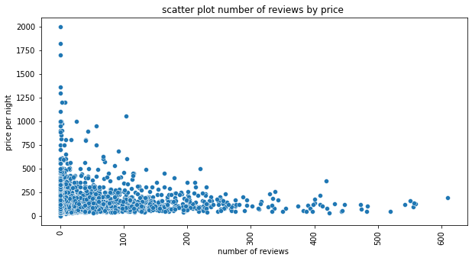
Scatter plot
Sns.scatterplot (x, y)
Is there a relationship between two numeric variables?
sns.scatterplot(x=abnb['number_of_reviews'], y=abnb['price’])
Can you see that as number of reviews increases(X) the price does what…

Slide 22
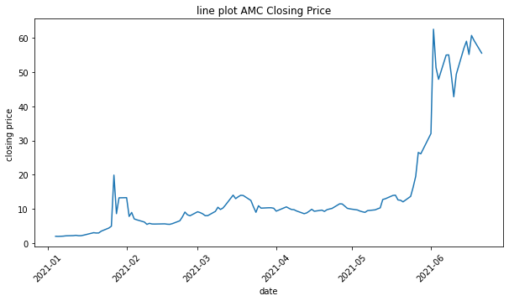
Line plot
Typically used for timeseries data
What is the y= < insert measure> by x=day, minute, month etc.
sns.lineplot(x=AMC['date'], y=AMC['close'])

Slide 23
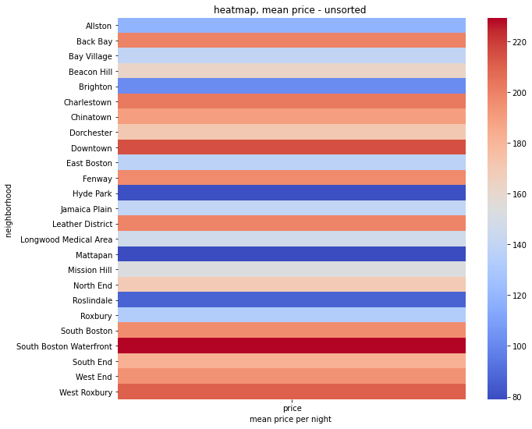
Heatmaps
Heatmaps are used to show relationships between two variables,
Basic Recipe
Summarize, into a 2-d matrix
Need row and column labels (typically)
Plot – heat maps Plot rectangular data as a color-encoded matrix.
res2 = pd.pivot_table(abnb, values=['price'], index='neighbourhood’,
aggfunc = 'mean', )
plt.figure(figsize=(10,9))
sns.heatmap(res2, cmap='coolwarm')
plt.title('heatmap, mean price - unsorted ')
plt.xlabel('mean price per night ')
plt.ylabel('neighborhood ')
plt.show()

Slide 24
5.3_Seaborn_Basics

Slide 25
Typical Python Project
Introduction
Load Libraries
Import Data
Eyeball first 5 records
Check nulls and data types with .info()
Convert datatypes if needed
Deal with data quality
Descriptive Statistics
Descriptive statistics for numeric columns
Explore Data
Histograms and boxplots for numeric data
Bar Charts for categorical data counts
Line Plots for timeseries

Slide 26
5.4 Restaurants in NYC – It’s a WRAP

Slide 27


